Slide 1
Chapter 25
The Age of Positivism: Realism, Impressionism, and the Pre-Raphaelites, 1848–1885

Slide 2
Learning Objectives
Define the word positivism, and describe how the rise of positivism, as well as the study of sociology, reflect the dramatic changes occurring in Western Civilization.
Assess the differing responses found in English and French art to the social transformations brought about by the Industrial Revolution toward 1850.
Track how French Realism changed as it developed from Gustav Courbet to Edouard Manet and Edgar Degas, and lastly to Claude Monet.
Describe the different attitudes toward the new medium of photography that surfaced in the 1840s, both by artists and the public in general, and how, in some respects, photography was the perfect visual medium for Age of Positivism.
Identify the period’s attitude toward the use of iron in architecture.

Slide 3
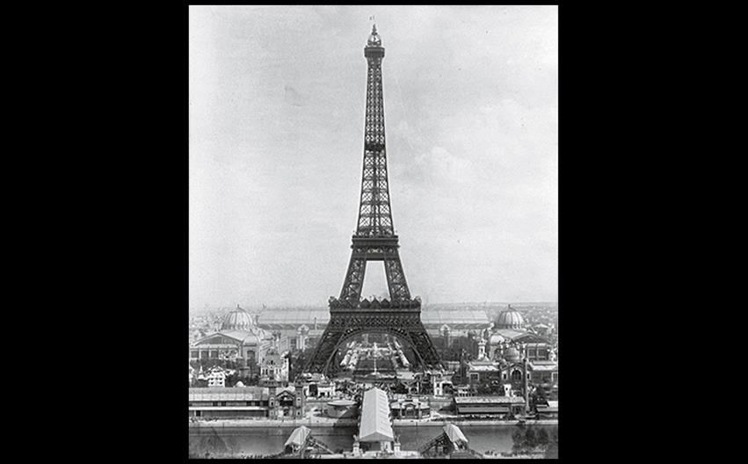
Gustave Eiffel EIFFEL TOWER, PARIS 1889 (also the date of this photograph). Height 984' (300 m). Courtesy the Library of Congress.
Notes:
Gustave Eiffel EIFFEL TOWER, PARIS 1889 (also the date of this photograph). Height 984' (300 m). Courtesy the Library of Congress.

Slide 4
Europe and the United States in the Mid to Late Nineteenth Century (1 of 2)
Advances in manufacturing, transportation, and communications created new products and wealth.
However, industrial laborers and owners of cottage industries suffered extensively.
Women demanded suffrage (only achieved in 1920) and many suffragists were also slavery abolitionists.

Slide 5
Europe and the United States in the Mid to Late Nineteenth Century (2 of 2)
The second half of the nineteenth century has been called the "positivist age" due to its faith in science.
The development of the telephone, radio, electrical lighting, vaccines, and disinfectant occurred.
Charles Darwin challenged Creation.
This paralleled the changes in art, but later abstract expression emerged.

Slide 6
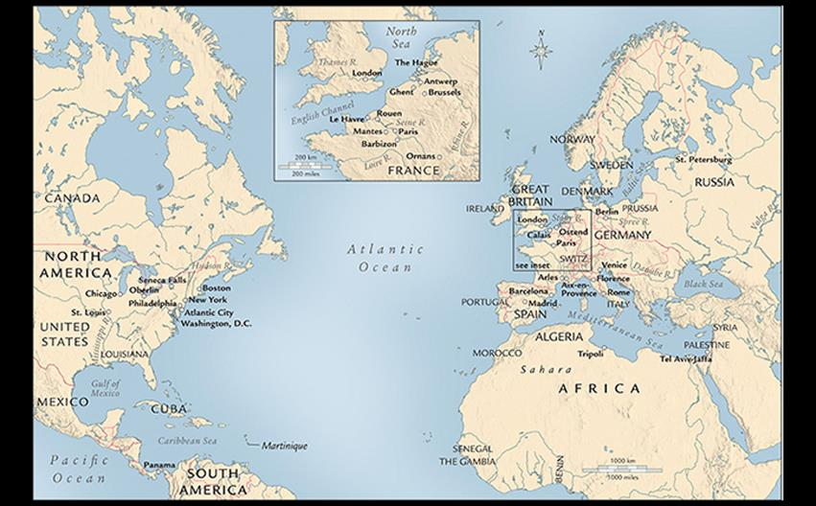
EUROPE AND THE UNITED STATES IN THE NINETEENTH CENTURY In the nineteenth century, Europe and the United States became increasingly industrialized, and many European nations established colonial possessions around the world. Paris was firmly established as the center of the Western art world.
Notes:
EUROPE AND THE UNITED STATES IN THE NINETEENTH CENTURY In the nineteenth century, Europe and the United States became increasingly industrialized, and many European nations established colonial possessions around the world. Paris was firmly established as the center of the Western art world

Slide 7
French Academic Architecture and Art
Public works were decorated with motifs drawn from historic models—historicism.
Historicists often combined allusions to other different historical periods in a single work.
Orientalist paintings arose, combining Egyptian, Turkish, and Indian cultures through symbolism.

Slide 8
Art and Its Contexts: Orientalism
The Snake Charmer by Jean-León Gérôme mixes Egyptian, Turkish, and Indian cultures in a fantastical and erotic work.
Edward Said describes Orientalism as the colonial gaze in which the Orient is viewed as something to possess, an "exotic" playground for the "civilized" European visitor.

Slide 9
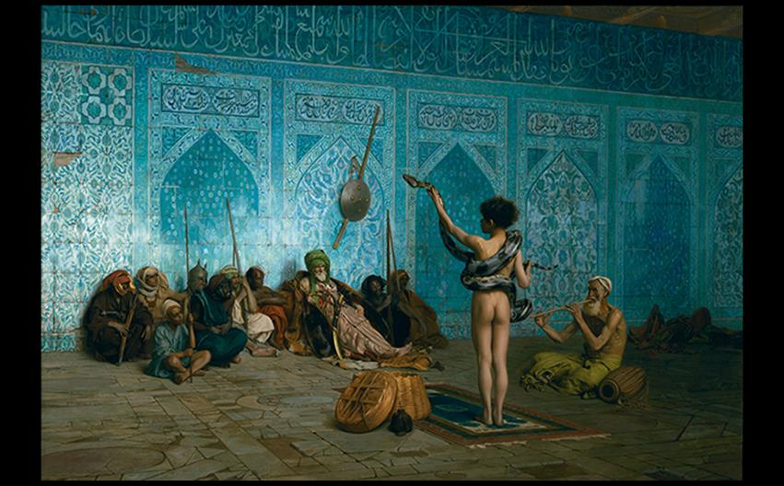
Jean-Léon Gérôme THE SNAKE CHARMER c. 1870. Oil on canvas, 33" × 48-1/8" (83.8 × 122.1 cm). Clark Art Institute, Williamstown, Massachusetts. Acquired by Sterling and Francine Clark, 1942. (1955.51). Bridgeman Images
Notes:
Jean-Léon Gérôme THE SNAKE CHARMER c. 1870. Oil on canvas, 33" × 48-1/8" (83.8 × 122.1 cm). Clark Art Institute, Williamstown, Massachusetts. Acquired by Sterling and Francine Clark, 1942. (1955.51). Bridgeman Images.

Slide 10
Academic Architecture
Charles Garnier constructed the Paris Opéra (opera house) with a cast-iron frame overlaid with nonstructural "neo-Baroque" decoration.
The opulent foyer staircase served as a stage for nobility.

Slide 11
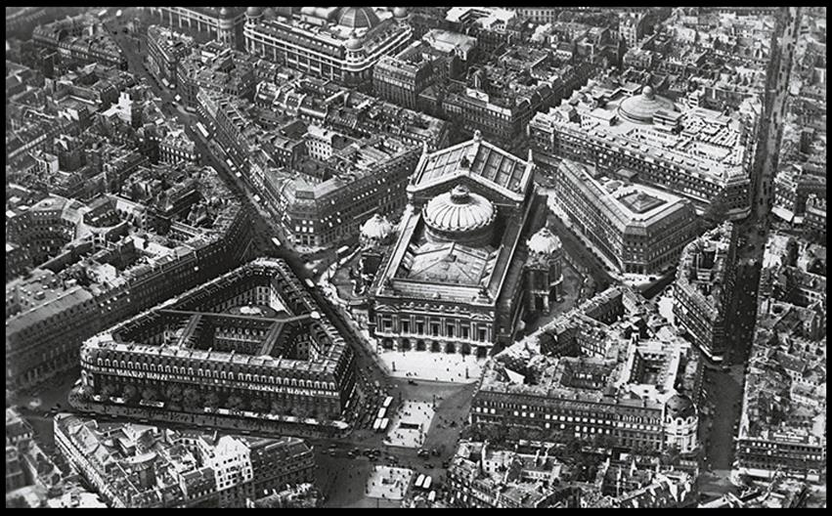
Charles Garnier OPÉRA, PARIS 1861–1874. © akg-images.
Notes:
Charles Garnier OPÉRA, PARIS 1861–1874. © akg-images.

Slide 12
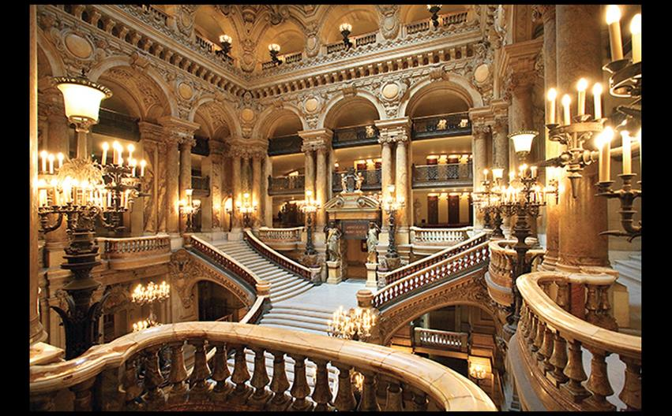
GRAND STAIRCASE, OPÉRA © John Kellerman/Alamy Stock Photo.
Notes:
GRAND STAIRCASE, OPÉRA © John Kellerman/Alamy Stock Photo.

Slide 13
Painting and Sculpture (1 of 2)
The Birth of Venus by Alexandre Cabanel represents the taste of the Académie des Beaux-Arts at the mid nineteenth century.
A combination of popular mythology and sexual allure characterizes this piece.
The won the Prix de Rome and went on to garner three-time top honors at the Salon.

Slide 14
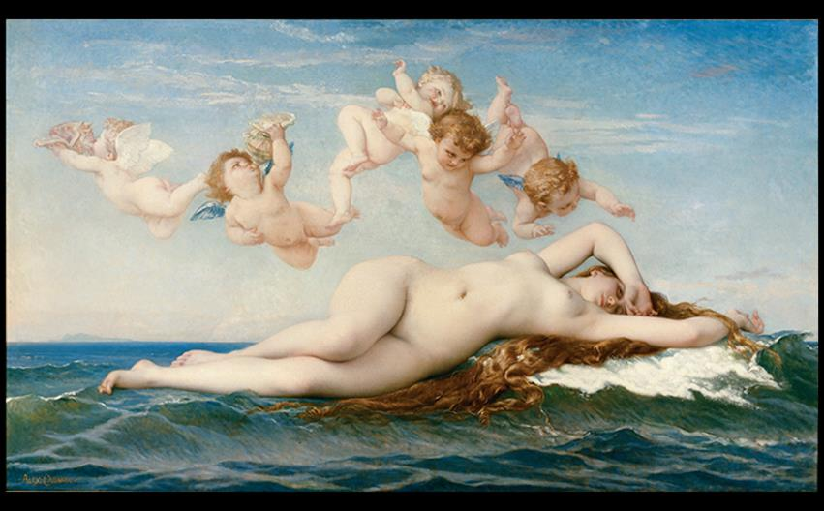
Alexandre Cabanel THE BIRTH OF VENUS 1863. Oil on canvas, 52" × 90" (1.35 × 2.29 m). Musée d'Orsay, Paris. Photo © RMN-Grand Palais (musée d'Orsay)/Hervé Lewandowski.
Notes:
Alexandre Cabanel THE BIRTH OF VENUS 1863. Oil on canvas, 52" × 90" (1.35 × 2.29 m). Musée d'Orsay, Paris. Photo © RMN-Grand Palais (musée d'Orsay)/Hervé Lewandowski.

Slide 15
Painting and Sculpture (2 of 2)
The works of Jean-Baptiste Carpeaux explore the deviations within the academy.
The Dance portrays a group of nude dancers in a somewhat spontaneous arrangement.
Unlike Neoclassical art, this piece contains figures that are more naturalistic than idealized.

Slide 16
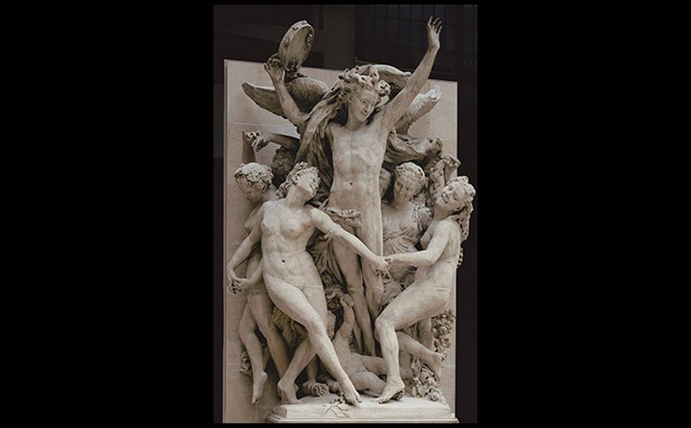
Jean-Baptiste Carpeaux THE DANCE 1867–1868. Plaster, height approx. 15' (4.6 m). Musée d'Orsay, Paris. © akg-images/Erich Lessing.
Notes:
Jean-Baptiste Carpeaux THE DANCE 1867–1868. Plaster, height approx. 15' (4.6 m). Musée d'Orsay, Paris. © akg-images/Erich Lessing.

Slide 17
Realism and the Avant-Garde
The avant-garde, "advance guard," was created in reaction to rigid academy training.
Artists gathered to transform modern industrialized and bourgeois society into an ideal state through radical art.
Architect Viollet-le-Duc believed that this would sacrifice reputations and reduce sales.

Slide 18
Realism and Revolution (1 of 6)
The Revolution of 1848 saw the overthrow of the monarchy and establishment of the Second Republic.
Conflicts among reformers led to the deaths of over 10,000 working poor.
Realism is less of a style and more of a commitment to paint the brutalities of the modern world with honesty.

Slide 19
Realism and Revolution (2 of 6)
Courbet
Gustave Courbet (1819–1877) turned to painting poor and ordinary people.
The Stone Breakers, destroyed in World War II, depicts a young boy and an old man crushing rocks.
The figures represent both an obsolete past and a grim future.
The work itself was the scale of a history painting.

Slide 20
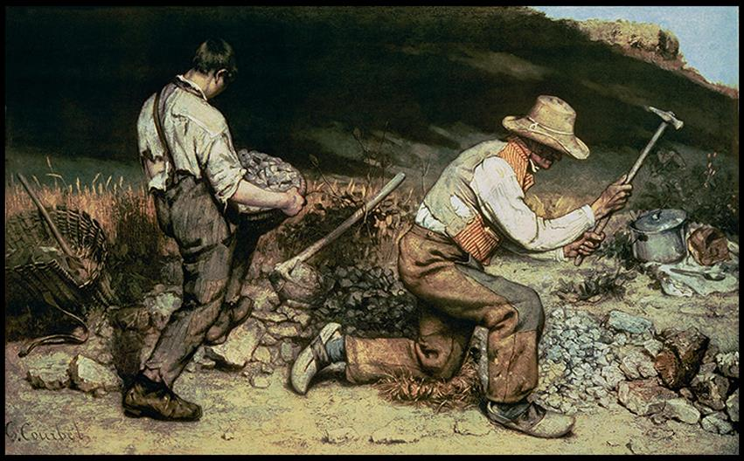
Gustave Courbet THE STONE BREAKERS 1849. Oil on canvas, 5'3" × 8'6" (1.6 × 2.59 m). Formerly Gemäldegalerie, Dresden; destroyed in World War II. © Staatliche Kunstsammlungen Dresden/Bridgeman Images.
Notes:
Gustave Courbet THE STONE BREAKERS 1849. Oil on canvas, 5'3" × 8'6" (1.6 × 2.59 m). Formerly Gemäldegalerie, Dresden; destroyed in World War II. © Staatliche Kunstsammlungen Dresden/Bridgeman Images.

Slide 21
Realism and Revolution (3 of 6)
Courbet
A Burial at Ornans commemorates the funeral of Courbet's grandfather.
Genuine sorry of mourners is contrasted by indifference of two Church officials.
The painting captures the physical reality of a funeral with awkward numbness.

Slide 22
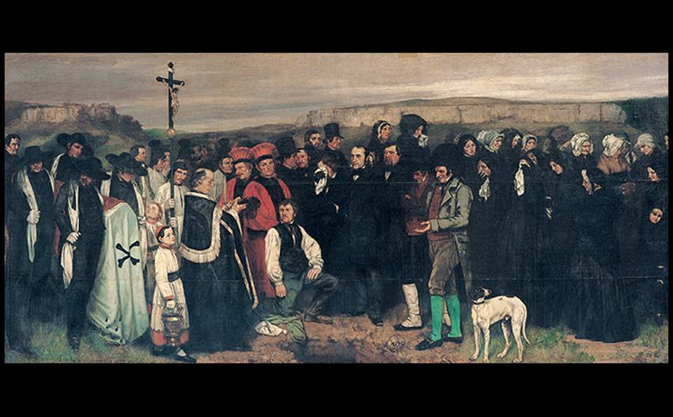
Gustave Courbet A BURIAL AT ORNANS 1849. Oil on canvas, 10'3-1/2" × 21'9" (3.1 × 6.6 m). Musée d'Orsay, Paris. Photo © RMN-Grand Palais (musée d'Orsay)/Gérard Blot/Hervé Lewandowski.
Notes:
Gustave Courbet A BURIAL AT ORNANS 1849. Oil on canvas, 10'3-1/2" × 21'9" (3.1 × 6.6 m). Musée d'Orsay, Paris. Photo © RMN-Grand Palais (musée d'Orsay)/Gérard Blot/Hervé Lewandowski.

Slide 23
Realism and Revolution (4 of 6)
Millet
Accusations of political radicalism were leveled against Courbet, and later against Jean-François Millet for his paintings' focus on rural life.
The Gleaners shows three women gathering left-over grain after harvest in a scene where warm colors contrast extreme poverty.
Millet would deny social criticism.

Slide 24
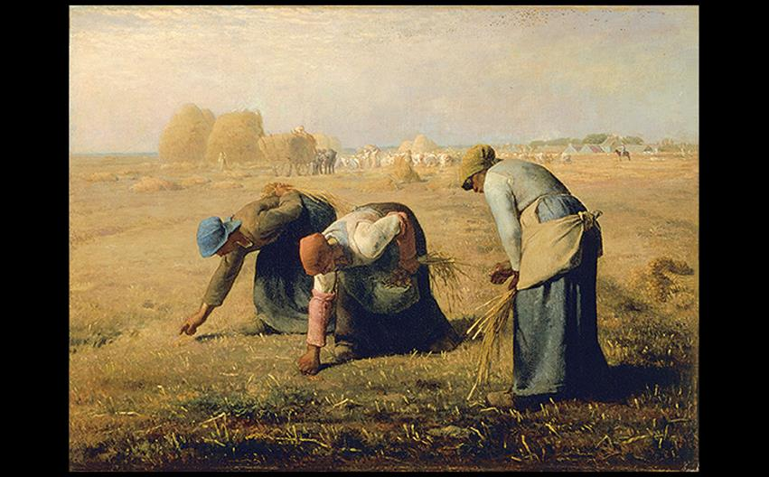
Jean-François Millet THE GLEANERS 1857. Oil on canvas, 33" × 44" (83.8 × 111.8 cm). Musée d'Orsay, Paris. Photo © RMN-Grand Palais (musée d'Orsay)/Jean Schormans.
Notes:
Jean-François Millet THE GLEANERS 1857. Oil on canvas, 33" × 44" (83.8 × 111.8 cm). Musée d'Orsay, Paris. Photo © RMN-Grand Palais (musée d'Orsay)/Jean Schormans.

Slide 25
Realism and Revolution (5 of 6)
Corot
Through a more romantic approach, Corot painted intimate scenes of rural France like First Leaves, Near Mantes.
Images of peaceful country life held appeal for Parisians sick of the crowded and chaotic metropolis.

Slide 26
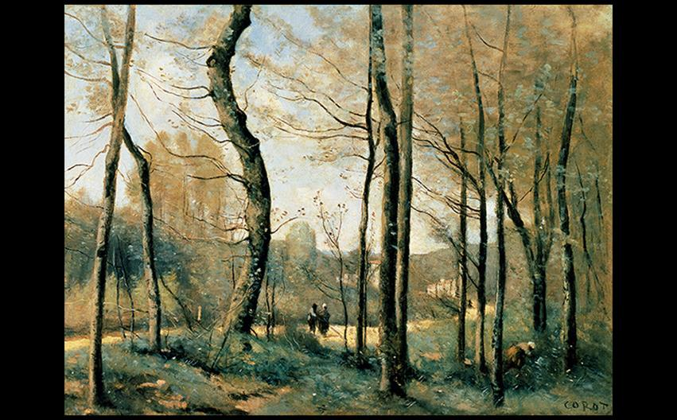
Jean-Baptiste-Camille Corot FIRST LEAVES, NEAR MANTES c. 1855. Oil on canvas, 13-3/8" × 18-1/8" (34 × 46 cm). Carnegie Museum of Art, Pittsburgh, Pennsylvania. Photograph © 2016 Carnegie Museum of Art, Pittsburgh. Photo: Richard Stoner.
Notes:
Jean-Baptiste-Camille Corot FIRST LEAVES, NEAR MANTES c. 1855. Oil on canvas, 13-3/8" × 18-1/8" (34 × 46 cm). Carnegie Museum of Art, Pittsburgh, Pennsylvania. Photograph © 2016 Carnegie Museum of Art, Pittsburgh. Photo: Richard Stoner.

Slide 27
Realism and Revolution (6 of 6)
Bonheur
Rosa Bonheur was a popular painter of French farm life.
She had to dress in men's clothing (with police permission) to make detailed studies in stockyards and slaughterhouses.
The Horse Fair was highly praised at the 1853 Salon, which was unusual for a painting of farm animals.

Slide 28
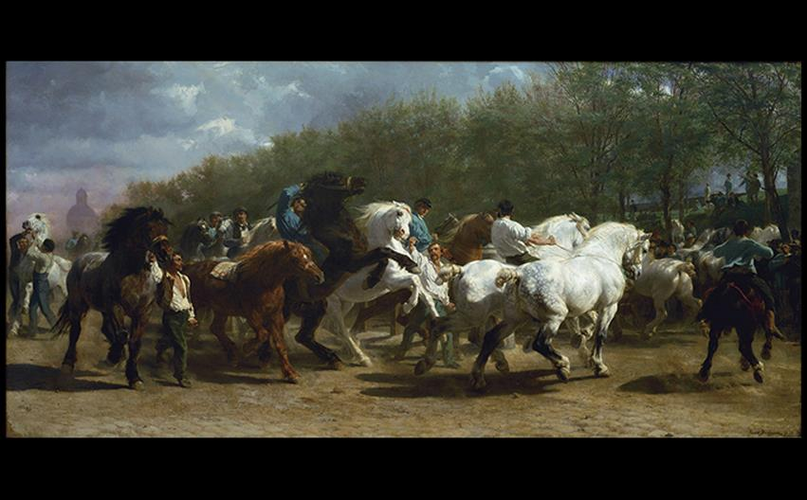
Rosa Bonheur THE HORSE FAIR 1853–1855. Oil on canvas, 8'-1/4" × 16'7-1/2" (2.45 × 5.07 m). Metropolitan Museum of Art, New York. © 2016. Image copyright The Metropolitan Museum of Art/Art Resource, NY/ Scala, Florence.
Notes:
Rosa Bonheur THE HORSE FAIR 1853–1855. Oil on canvas, 8'-1/4" × 16'7-1/2" (2.45 × 5.07 m). Metropolitan Museum of Art, New York. © 2016. Image copyright The Metropolitan Museum of Art/Art Resource, NY/ Scala, Florence.

Slide 29
Manet: "The Painter of Modern Life" (1 of 4)
Themes of the modern city and politics are key to understanding the trends that developed in Paris at this time.
Édouard Manet became the unofficial leader of a group of artists and writers who pushed the French Realist tradition into new territory.

Slide 30
Manet: "The Painter of Modern Life" (2 of 4)
Luncheon on the Grass
Manet offered flat, sharply outlined, and starkly lit figures who stand out against their setting.
In a nod to Titian's Pastoral Concert, a completely naked woman is seated next to two fully clothed bourgeois men.
This nudity was scandalous as it was not part of mythological or historical narrative, but within contemporary life.

Slide 31
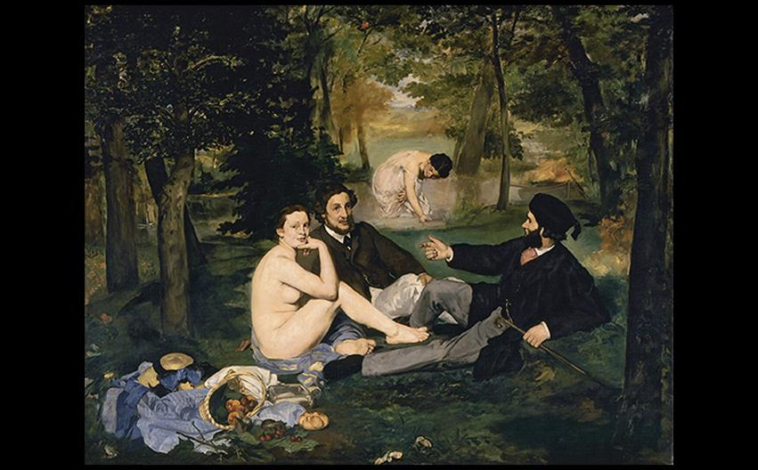
Édouard Manet THE LUNCHEON ON THE GRASS/LE DÉJEUNER SUR L'HERBE 1863. Oil on canvas, 7' × 8'8" (2.13 × 2.64 m). Musée d'Orsay, Paris. Photo © RMN-Grand Palais (musée d'Orsay)/Hervé Lewandowski.
Notes:
Édouard Manet THE LUNCHEON ON THE GRASS/LE DÉJEUNER SUR L'HERBE 1863. Oil on canvas, 7' × 8'8" (2.13 × 2.64 m). Musée d'Orsay, Paris. Photo © RMN-Grand Palais (musée d'Orsay)/Hervé Lewandowski.

Slide 32
Manet: "The Painter of Modern Life" (3 of 4)
Olympia
The title alludes to a socially ambitious prostitute of the same name in a novel and play by Alexandre Dumas fils.
It is based on Titian's "Venus" of Urbino, but instead of a curvaceous and round nude, Manet's subject is angular and flattened.
The tradition of the accommodating female nude is subverted by her gaze.

Slide 33
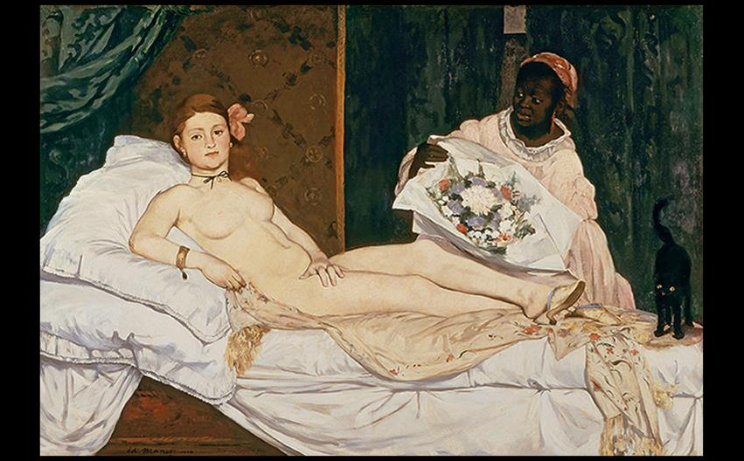
Édouard Manet OLYMPIA 1863. Oil on canvas, 4'3" × 6'2-1/4" (1.31 × 1.91 m). Musée d'Orsay, Paris. Photo © RMN-Grand Palais (musée d'Orsay).
Notes:
Édouard Manet OLYMPIA 1863. Oil on canvas, 4'3" × 6'2-1/4" (1.31 × 1.91 m). Musée d'Orsay, Paris. Photo © RMN-Grand Palais (musée d'Orsay).

Slide 34
Manet: "The Painter of Modern Life" (4 of 4)
Later Works
A Bar at the Folies-Bergère portrays a girl hard at work in a bar, maintaining Manet's dedication to painting modern urban life.
The piece acknowledges both her class and gender; both she and the products she sells appear to be available for purchase.

Slide 35
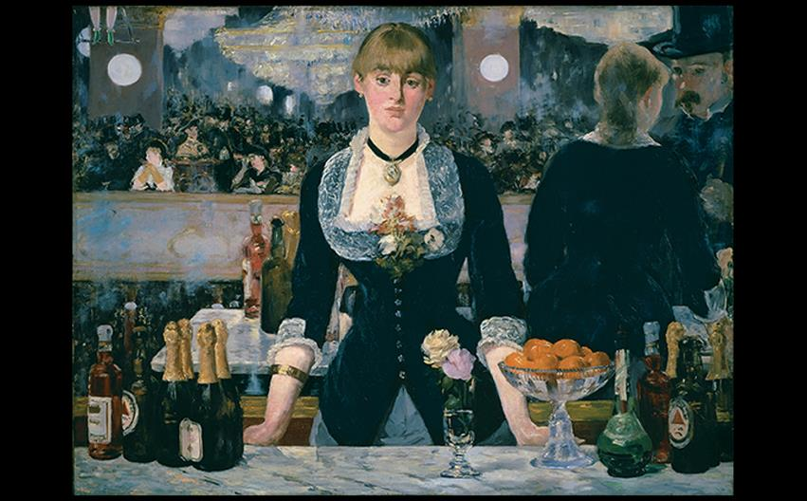
Édouard Manet A BAR AT THE FOLIES-BERGÈRE 1881–1882. Oil on canvas. 37-3/4" × 51-1/4" (95.9 × 130 cm). The Samuel Courtauld Trust, The Courtauld Gallery, London. (P.1934.SC.234). © Samuel Courtauld Trust, The Courtauld Gallery, London, UK/Bridgeman Images.
Notes:
Édouard Manet A BAR AT THE FOLIES-BERGÈRE 1881–1882. Oil on canvas. 37-3/4" × 51-1/4" (95.9 × 130 cm). The Samuel Courtauld Trust, The Courtauld Gallery, London. (P.1934.SC.234). © Samuel Courtauld Trust, The Courtauld Gallery, London, UK/Bridgeman Images.

Slide 36
Responses to Realism Beyond France (1 of 9)
Social effects of urbanization and industrialization in other countries led to movements of art not labeled "Realism," but called the same manner of attention to the same bleak reality the working poor experienced.

Slide 37
Responses to Realism Beyond France (2 of 9)
Realism in Russia: The Wanderers
Reacting against escapist aesthetics of the St. Petersburg Academy of Art, a group of artists reasserted what they called authentic Russian culture.
Bargehaulers on the Volga evoked sympathy for a group of peasants in a call to action against the labor practices on the Volga River.

Slide 38
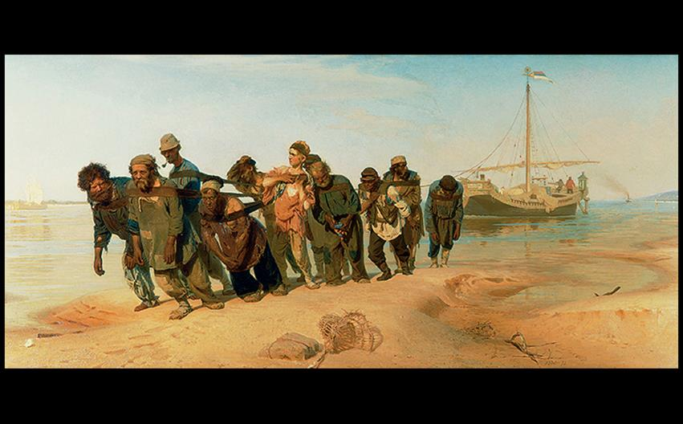
Ilya Repin BARGEHAULERS ON THE VOLGA 1870–1873. Oil on canvas, 4'3-3/4" × 9'3" (1.3 × 2.81 m). State Russian Museum, St. Petersburg. © akg-images.
Notes:
Ilya Repin BARGEHAULERS ON THE VOLGA 1870–1873. Oil on canvas, 4'3-3/4" × 9'3" (1.3 × 2.81 m). State Russian Museum, St. Petersburg. © akg-images.

Slide 39
Responses to Realism Beyond France (3 of 9)
Realism in the United States: A Continuing Tradition
Realism was unbroken in American painting as far back as Colonial portrait painters.
Philadelphia artist Thomas Eakins specialized in frank portraits.
The Gross Clinic was controversial because surgery was deemed an unfit subject for art.

Slide 40
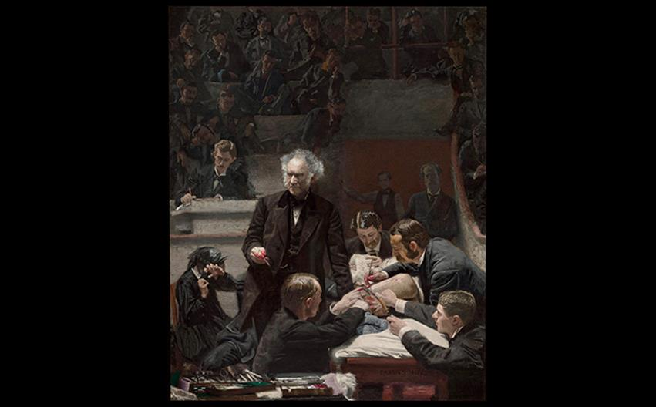
Thomas Eakins THE GROSS CLINIC 1875. Oil on canvas, 8' × 6'5" (2.44 × 1.98 m). Philadelphia Museum of Art, Pennsylvania. Gift of the Alumni Association to Jefferson Medical College in 1878 and purchased by the Pennsylvania Academy of the Fine Arts and the Philadelphia Museum of Art in 2007. © 2016. Photo The Philadelphia Museum of Art/Art Resource/Scala, Florence.
Notes:
Thomas Eakins THE GROSS CLINIC 1875. Oil on canvas, 8' × 6'5" (2.44 × 1.98 m). Philadelphia Museum of Art, Pennsylvania. Gift of the Alumni Association to Jefferson Medical College in 1878 and purchased by the Pennsylvania Academy of the Fine Arts and the Philadelphia Museum of Art in 2007. © 2016. Photo The Philadelphia Museum of Art/Art Resource/Scala, Florence.

Slide 41
Responses to Realism Beyond France (4 of 9)
Realism in the United States: A Continuing Tradition
Winslow Homer was a reporter and illustrator for Harper's Weekly, producing works of the Civil War.
Later, he created The Life Line, depicting a coast guard saving a shipwrecked woman with a breeches buoy.

Slide 42
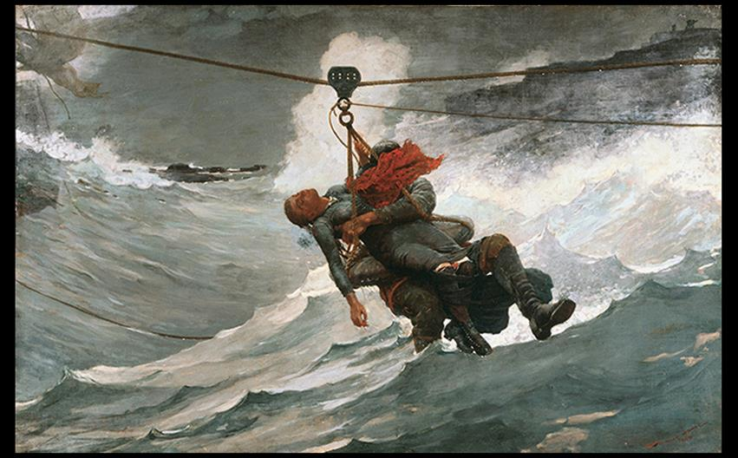
Winslow Homer THE LIFE LINE 1884. Oil on canvas, 28-3/4" × 44-5/8" (73 × 113.3 cm). Philadelphia Museum of Art, Pennsylvania. The George W. Elkins Collection, 1924. © 2016. Photo The Philadelphia Museum of Art/Art Resource/Scala, Florence.
Notes:
Winslow Homer THE LIFE LINE 1884. Oil on canvas, 28-3/4" × 44-5/8" (73 × 113.3 cm). Philadelphia Museum of Art, Pennsylvania. The George W. Elkins Collection, 1924. © 2016. Photo The Philadelphia Museum of Art/Art Resource/Scala, Florence.

Slide 43
Responses to Realism Beyond France (5 of 9)
Realism in the United States: A Continuing Tradition
Edmonia Lewis created highly successful busts and medallions of abolitionist leaders and Civil War heroes.
Inspired by the struggle of recently freed slaves for equality, she created Forever Free to commemorate the Emancipation Proclamation.

Slide 44
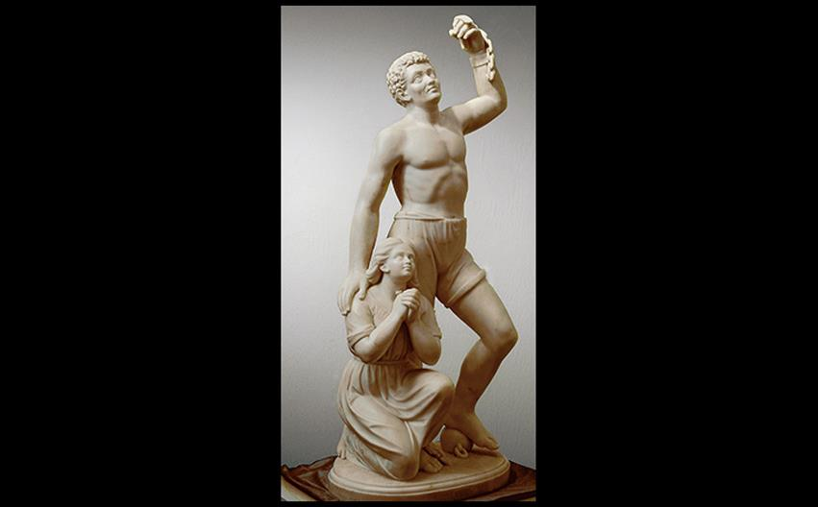
Edmonia Lewis FOREVER FREE 1867. Marble, 41-1/4 × 22 × 17" (104.8 × 55 × 43.2 cm). Howard University Gallery of Art, Washington, DC.
Notes:
Edmonia Lewis FOREVER FREE 1867. Marble, 41-1/4 × 22 × 17" (104.8 × 55 × 43.2 cm). Howard University Gallery of Art, Washington, DC.

Slide 45
Responses to Realism Beyond France (6 of 9)
Realism in the United States: A Continuing Tradition
Henry Ossawa Tanner's painting received favorable critical attention after he moved from Atlanta to Paris.
The Banjo Lesson is a humanizing image of African-American life, where an elderly man teaches a young boy with serious concentration.

Slide 46
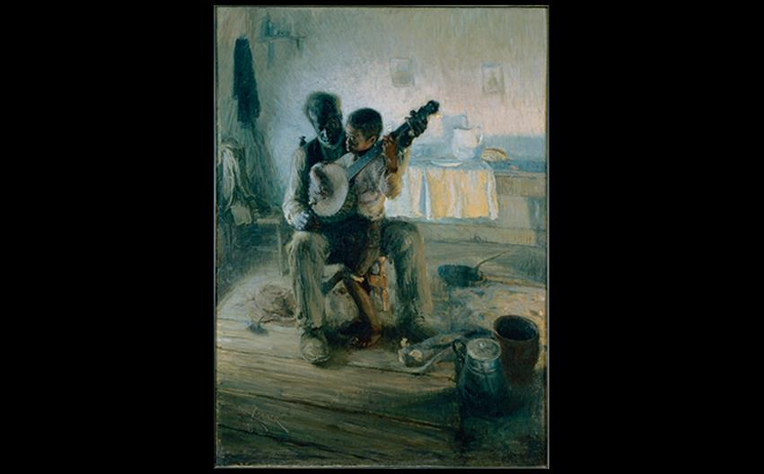
Henry Ossawa Tanner THE BANJO LESSON 1893. Oil on canvas, 49 × 35-1/2" (124.4 × 90 cm). Hampton University Museum, Virginia. Hampton University’s Archival and Museum Collection Hampton University.
Notes:
Henry Ossawa Tanner THE BANJO LESSON 1893. Oil on canvas, 49 × 35-1/2" (124.4 × 90 cm). Hampton University Museum, Virginia. Hampton University’s Archival and Museum Collection Hampton University.

Slide 47
Responses to Realism Beyond France (7 of 9)
Developments in Britain
In England, artists looked to art of the Middle Ages and Early Renaissance for beauty, naturalism, and moralizing spirituality they found was lacking.
Rossetti's La Pia de' Tolomei illustrates a story from Dante's Purgatory.
It is rich with symbolism, implying that La Pia (the pious one) is a captive within her marriage.

Slide 48
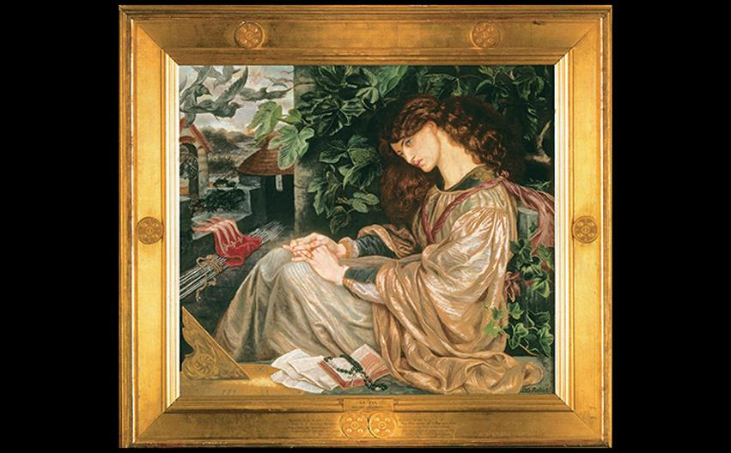
Dante Gabriel Rossetti LA PIA DE' TOLOMEI 1868–1869. Oil on canvas, 41-1/2" × 47-1/2" (105.4 × 119.4 cm). Spencer Museum of Art, The University of Kansas. (1956.0031)
Notes:
Dante Gabriel Rossetti LA PIA DE' TOLOMEI 1868–1869. Oil on canvas, 41-1/2" × 47-1/2" (105.4 × 119.4 cm). Spencer Museum of Art, The University of Kansas. (1956.0031)

Slide 49
Responses to Realism Beyond France (8 of 9)
Developments in Britain
William Morris argued for handcrafted objects over gaudy and shoddy industrially-produced goods.
He founded a decorating firm to produce a full range of domestic products.
Some products were relatively affordable, such as the rush-seated Chair shown on the next slide.

Slide 50
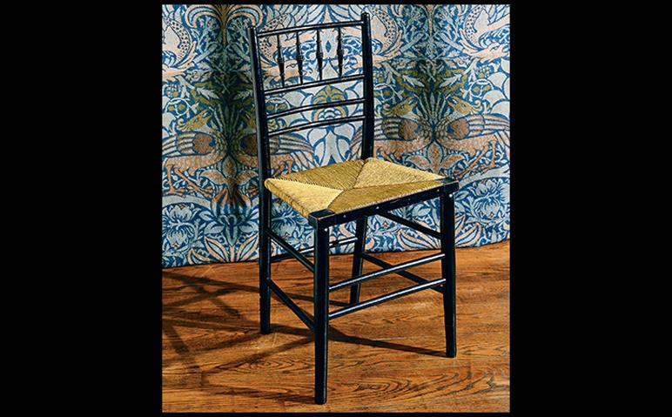
Philip Webb and William Morris "SUSSEX" CHAIR and "PEACOCK AND DRAGON" CURTAIN Chair (by Webb): In production from c. 1865. Ebonized wood with rush seat, 33" × 16 1/2" × 14" (83.8 × 42 × 35.6 cm). Curtain (by Morris): 1878. Handloomed jacquard-woven woolen twill, 12'10-1/2" × 11'5-5/8" (3.96 × 3.53 m). Chair and curtain manufactured by Morris & Company. The William Morris Gallery, London Borough of Waltham Forest. The William Morris Gallery, London, E17, England.
Notes:
Philip Webb and William Morris "SUSSEX" CHAIR and "PEACOCK AND DRAGON" CURTAIN Chair (by Webb): In production from c. 1865. Ebonized wood with rush seat, 33" × 16 1/2" × 14" (83.8 × 42 × 35.6 cm). Curtain (by Morris): 1878. Handloomed jacquard-woven woolen twill, 12'10-1/2" × 11'5-5/8" (3.96 × 3.53 m). Chair and curtain manufactured by Morris & Company. The William Morris Gallery, London Borough of Waltham Forest. The William Morris Gallery, London, E17, England.

Slide 51
Responses to Realism Beyond France (9 of 9)
Developments in Britain
James Abbott McNeill Whistler sought to satisfy an elitist taste for pure beauty.
His art was of pure aesthetic value.
Nocturne in Black and Gold, the Falling Rocket depicts a fireworks show with several observers in the foreground.
It was criticized as unfinished, or as flinging paint in the audience's face.

Slide 52
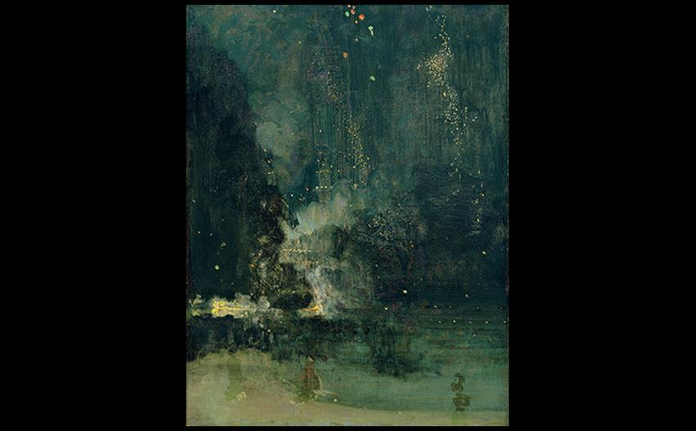
James Abbott McNeill Whistler NOCTURNE IN BLACK AND GOLD, THE FALLING ROCKET 1875. Oil on panel, 23-3/4" × 18-3/8" (60.2 × 46.7 cm). The Detroit Institute of Arts. Gift of Dexter M. Ferry Jr. (46.309). Bridgeman Images.
Notes:
James Abbott McNeill Whistler NOCTURNE IN BLACK AND GOLD, THE FALLING ROCKET 1875. Oil on panel, 23-3/4" × 18-3/8" (60.2 × 46.7 cm). The Detroit Institute of Arts. Gift of Dexter M. Ferry Jr. (46.309). Bridgeman Images.

Slide 53
Art and Its Contexts: Art on Trial in 1877
The trial that James Abbott McNeill Whistler initiated against critic John Ruskin ended in favor of the artist, whom Ruskin had libeled.
However, in those days, the person who brought the suit had to pay all court costs; this bankrupted the artist.

Slide 54
Impressionism
Artists began to paint outdoors, en plein air in an effort to record fleeting effects of light and atmosphere.
A group under the organization of Camille Pissarro urged artists to band into grass-roots organizations rather than rely on state-sanctioned institutions.
Their exhibitions drew relative success.

Slide 55
Landscape and Leisure (1 of 6)
The Franco–Prussian War of 1870 and the deaths of over 20,000 people rocked Paris and led to the diminishment of political commentary in French art.
Impressionists sought to celebrate semirural outings afforded by the Paris train system.

Slide 56
Landscape and Leisure (2 of 6)
Monet's painting, Impression, Sunrise, was how the Impressionist movement was named.
A critic meant for it to mock the open brushstrokes and unfinished look, but Monet and his colleagues felt it aptly described their aim of depicting a fleeting moment.

Slide 57
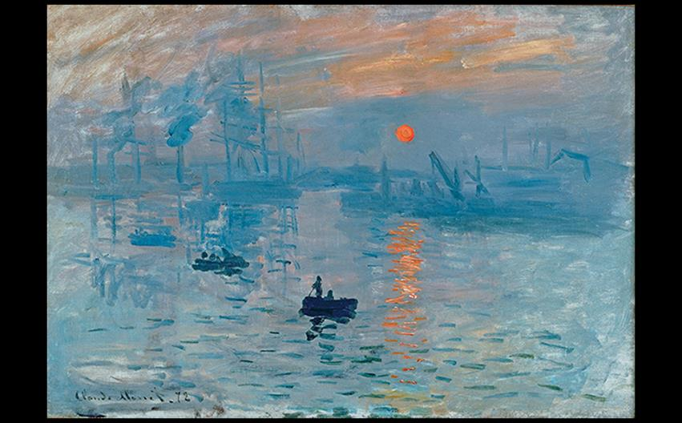
Claude Monet IMPRESSION: SUNRISE 1872. Oil on canvas, 19" × 24-3/8" (48 × 63 cm). Musée Marmottan, Paris. Bridgeman Images.
Notes:
Claude Monet IMPRESSION: SUNRISE 1872. Oil on canvas, 19" × 24-3/8" (48 × 63 cm). Musée Marmottan, Paris. Bridgeman Images.

Slide 58
Landscape and Leisure (3 of 6)
Monet painted the façade of the Rouen Cathedral on over 30 canvases.
Rather than for religious reasons, Monet's fascination with this particular cathedral involved the way the light changed the façade constantly.

Slide 59
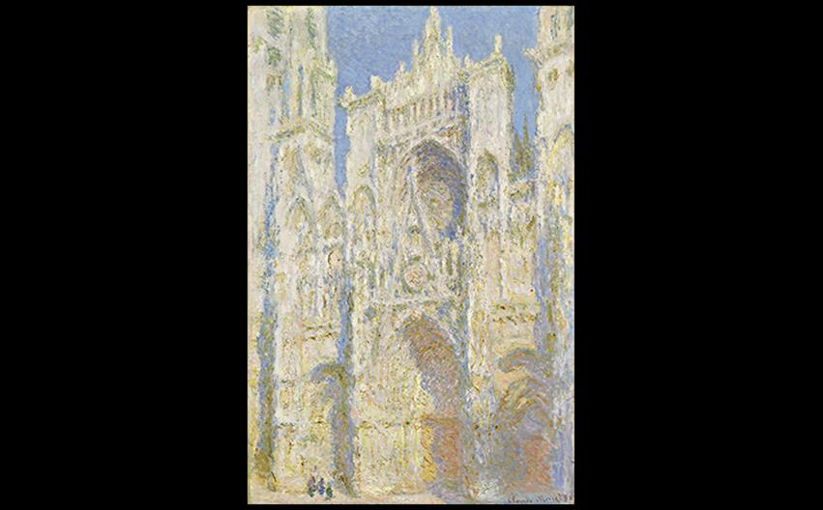
Claude Monet ROUEN CATHEDRAL, WEST FAÇADE, SUNLIGHT 1894. Oil on canvas, 39-3/8 × 25-7/8" (100.1 × 65.8 cm). National Gallery of Art, Washington, D.C., Chester Dale Collection (1963.10.179). Image courtesy the National Gallery of Art, Washington.
Notes:
Claude Monet ROUEN CATHEDRAL, WEST FAÇADE, SUNLIGHT 1894. Oil on canvas, 39-3/8 × 25-7/8" (100.1 × 65.8 cm). National Gallery of Art, Washington, D.C., Chester Dale Collection (1963.10.179). Image courtesy the National Gallery of Art, Washington.

Slide 60
Landscape and Leisure (4 of 6)
Camille Pissarro painted scenes where urban visitors were embedded within a rural countryside.
Wooded Landscape at L'Hermitage, Pontoise is composed of a village shrouded in a screen of trees.

Slide 61
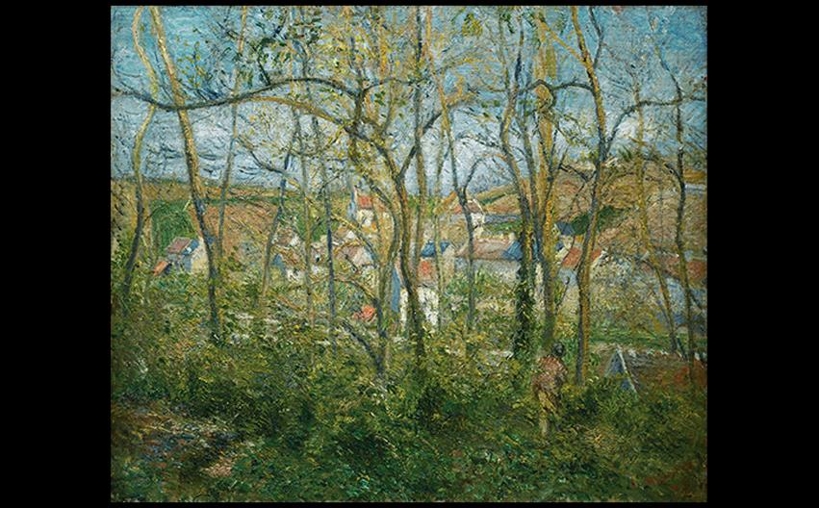
Camille Pissarro WOODED LANDSCAPE AT L'HERMITAGE, PONTOISE 1878. Oil on canvas, 18-5/16" × 22-1/16" (46.5 × 56 cm). The Nelson-Atkins Museum of Art, Kansas City, Missouri. Gift of Dr. and Mrs. Nicholas S. Pickard.
Notes:
Camille Pissarro WOODED LANDSCAPE AT L'HERMITAGE, PONTOISE 1878. Oil on canvas, 18-5/16" × 22-1/16" (46.5 × 56 cm). The Nelson-Atkins Museum of Art, Kansas City, Missouri. Gift of Dr. and Mrs. Nicholas S. Pickard.

Slide 62
Landscape and Leisure (5 of 6)
Pierre-Auguste Renoir focused his attention on depicting the middle class at leisure.
Moulin de la Galette shows the relaxed and informal crowd at a dance hall.
The artist sought to capture a carefree life, a paradise removed from the real world.

Slide 63
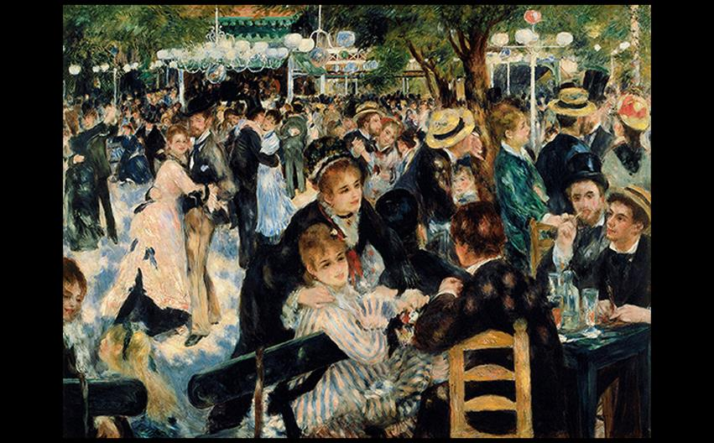
Pierre-Auguste Renoir MOULIN DE LA GALETTE 1876. Oil on canvas, 4'3-1/2" × 5'9" (1.31 × 1.75 m). Musée d'Orsay, Paris. Photo © RMN-Grand Palais (musée d'Orsay)/Hervé Lewandowski.
Notes:
Pierre-Auguste Renoir MOULIN DE LA GALETTE 1876. Oil on canvas, 4'3-1/2" × 5'9" (1.31 × 1.75 m). Musée d'Orsay, Paris. Photo © RMN-Grand Palais (musée d'Orsay)/Hervé Lewandowski.

Slide 64
Landscape and Leisure (6 of 6)
Berthe Morisot married Edouard Manet's brother and continued painting even after the birth of her daughter.
Her art was dedicated to the lives of bourgeois women, such as in Summer's Day.
This painting exemplifies the emphasis on formal features in Impressionist painting.

Slide 65
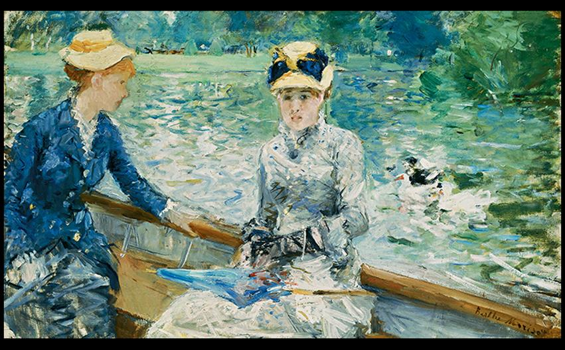
Berthe Morisot SUMMER'S DAY 1879. Oil on canvas, 17-13/16" × 29-5/16" (45.7 × 75.2 cm). National Gallery, London. Lane Bequest, 1917. © 2016. Copyright The National Gallery, London/Scala, Florence.
Notes:
Berthe Morisot SUMMER'S DAY 1879. Oil on canvas, 17-13/16" × 29-5/16" (45.7 × 75.2 cm). National Gallery, London. Lane Bequest, 1917. © 2016. Copyright The National Gallery, London/Scala, Florence.

